Slide 1
PROPAGATION DELAY, TRISTATE LOGIC & IT’S APPLICATIONS

Slide 2
CONTENTS
Transistor as a Switch,
Characteristics of Digital ICs, DL, RTL, DTL, TTL, ECL, IIL,
Characteristics and uses of MOSFET (CS, Common drain and Common gate),
MOSFET Logic, PMOS,NMOS, CMOS Logic,
Propagation delay,
Tristate Logic, Tristate Logic Applications,
FPGA Basics,
Introduction to HDL and logic simulation,
HDL System primitives,
user defined primitives,
Stimulus to the design,

Slide 3
PROPAGATION DELAY
Every logic gate experiences some delay (though very small) in propagating signals forward, This delay is called Gate (Propagation) Delay(tPD).
Formally, it is the average transition time taken for the output signal of the gate to change in response to changes in the input signals.
Three different propagation delay times associated with a logic gate:
tPHL: output changing from the High level to Low level
tPLH: output changing from the Low level to High level
tPD=(tPLH + tPHL)/2 (average propagation delay)

Slide 4
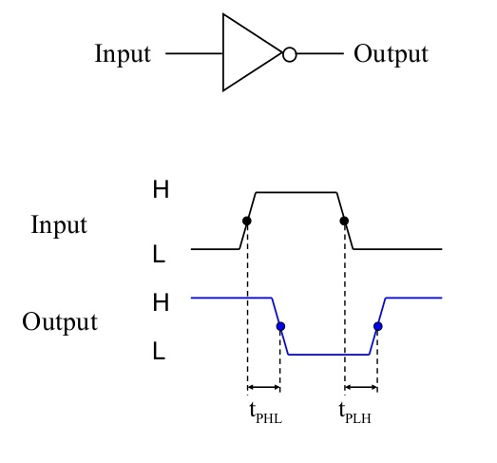
PROPAGATION DELAY

Slide 5
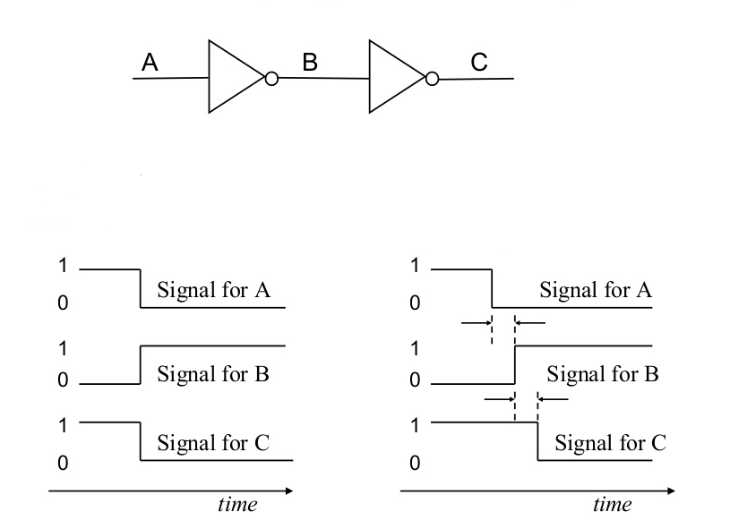
PROPAGATION DELAY
Ideally no delay:
In reality, output signals normally lag behind input signals:

Slide 6
PROPAGATION DELAY
Calculation of Circuit Delays:
Amount of propagation delay per gate depends on:
gate type (AND, OR, NOT, etc)
transistor technology used (TTL,ECL,CMOS etc),
miniaturization (SSI, MSI, LSI, VLSI)
To simplify matters, one can assume
an average delay time per gate, or
an average delay time per gate-type.
Propagation delay of logic circuit
= longest time it takes for the input signal(s) to propagate to the output(s)
= earliest time for output signal(s) to stabilize, given that input signals are stable at time 0

Slide 7
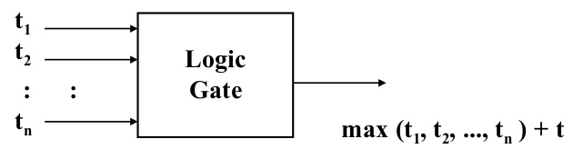
PROPAGATION DELAY
Calculation of Circuit Delays:
In general, given a logic gate with delay, t
If inputs are stable at times t1,t2,..,tn, respectively; then the earliest time in which the output will be stable is:
max(t1, t2, .., tn) + t

Slide 8
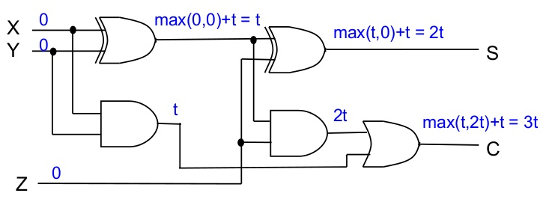
PROPAGATION DELAY
Calculation of Circuit Delays:
As a simple example, consider the full adder circuit where all inputs are available at time 0. (Assume each gate has delay t.)
where outputs S and C, experience delays of 2t and 3t, respectively.

Slide 9
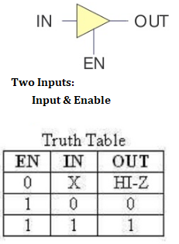
Tristate (Three-State) Logic
Tristate output combines the advantages of the IN OUT totem-pole and open collector circuits
Three output states are HIGH, LOW, and high EN impedance (Hi-Z)
For the symbol and truth table, IN is the data input and enable input, and EN, the additional enable input for control
For EN = 0, regardless of the value on IN (denoted by X), the output value is Hi-Z
For EN = 1, the output value follows the input value
Variations:
Data input, IN, can be inverted
EN is to make output Hi-Z or Control input, EN, can be inverted by addition of "bubbles" to signals
EN is to make output Hi-Z or follow input

Slide 10
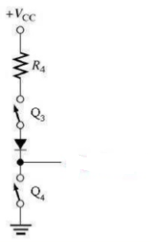
Tristate (Three-State) Logic
Hi-Impedance Outputs
Tristate gate utilize the high-speed operation of the totem-pole arrangement when input enabled
Permit outputs to be connected together
What is a Hi-Z value?
Both transistor are turned off in the totem- pole arrangement
This means that, looking back into the circuit, the output appears to be disconnected
High Z-Output
An equivalent circuit (open circuit) for the tristate output in the high-Z state

Slide 11
Tristate (Three-State) Logic
Applications:
Three-state buffers can be used to implement efficient multiplexers, especially those with large numbers of inputs.
Three-state buffers are essential to the operation of a shared electronic bus.
Three-state logic can reduce the number of wires needed to drive a set of LEDs (tri-state multiplexing or Charlieplexing).

